Slide 1
The safest, most cost-effective model for patient care is physician-led, team-based healthcare: Literature Review
September 10, 2025
Rebekah Bernard, MD, FAAFP
Phil Shaffer, MD

Slide 2
Purpose
We will examine data cited by the AANP and the South Carolina Nurses Association for the proposition that it is safe and effective for nurse practitioners to practice without physician supervision.
What you will see after a close examination of the data is that this claim is not supported

Slide 3
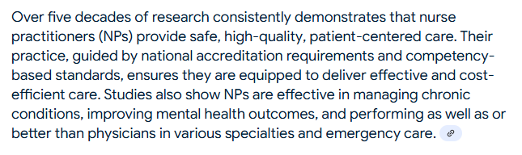
“Five decades of research”
* When functioning in physician-led care teams
Source: American Association of Nurse Practitioners

Slide 4
Studies show that NPs and PAs can provide quality care in physician-led care teams
In addition to being supervised, NP/PA studies:
- Evaluate minor/ self-limited issues or exclude high risk patients
- involve previously diagnosed patients (not undifferentiated)
There are NO randomized, controlled studies evaluating care by unsupervised NPs/ PAs (even though NPs have had unsupervised practice rights in some states for decades)

Slide 5
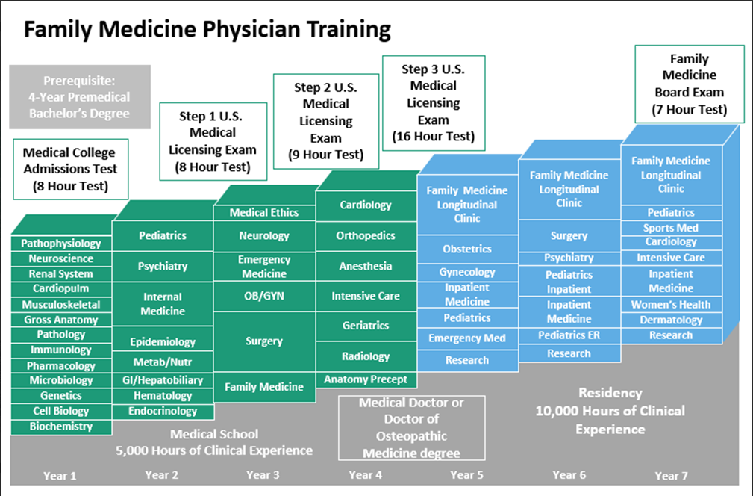
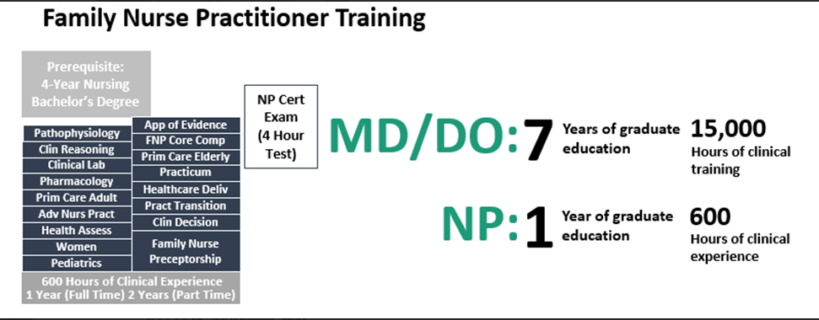

** Average FNP has 686 hours

Slide 6
Learning to DIAGNOSE (the hard part of medicine)
A patient coming in for evaluation of a new problem is called ‘undifferentiated.’ We don’t know what’s wrong with them…. yet
EXAMPLE: Patient comes in with a ‘sore throat’

Slide 7
Differential diagnosis for sore throat
1. Virus (rhinovirus/ common cold)
2. Bacteria (strep throat)
3. Allergic rhinitis/ postnasal drip

Slide 8
Differential diagnosis for sore throat
1. Viral (rhinovirus/ common cold)
- a, b, c, d… Influenza, COVID19, herpes virus, mononucleosis….
2. Bacteria (strep throat)
- a, b, c, d…. Diphtheria, gonorrhea, chlamydia, H. flu, Fusobacterium
  **** rule out emergencies like epiglottitis, Peritonsillar abscess, retropharyngeal abscess, Lemierre’s
3. Allergic rhinitis/ postnasal drip
4. GERD/ acid reflux
5. Foreign body
6. Malignancy: pharyngeal cancer, leukemia
7. Autoimmune disease: Behcet’s syndrome
8. Autoinflammatory disorders: Periodic fever with aphthous stomatitis, pharyngitis, and adenitis (PFAPA syndrome)

Slide 9
How doctors learn to diagnose
Studying all the possible causes of disease (“The eye cannot see what the mind does not know”) - This takes A LONG TIME
THEN… learning how to ‘rule in’ and ‘rule out’ potential causes: History/ physical exam and diagnostic testing (lab, xray)
Most importantly: Knowing when it’s an emergency/ very serious

Slide 10
Studies on NPs and PAs
Never measure the clinician’s ability to properly DIAGNOSE patients (evaluate ‘undifferentiated’ patients) without physician involvement
Never measure the clinician’s ability to manage HIGH RISK, acutely ill patients without physician involvement
AND YET… Legislation would allow NPs/PAs to treat ALL South Carolina patients, no matter how complex or ill

Slide 11
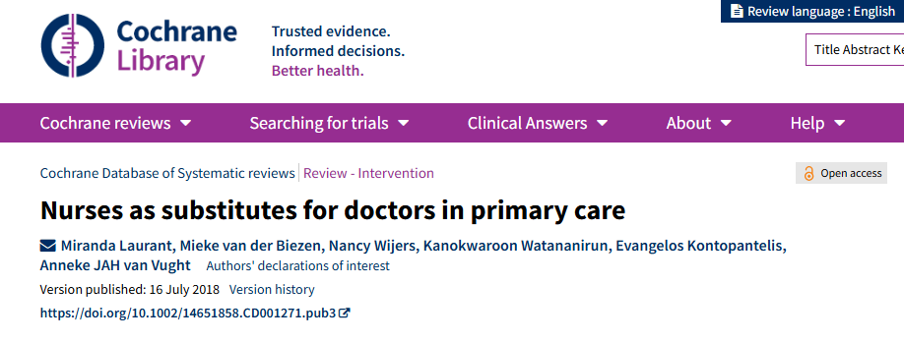
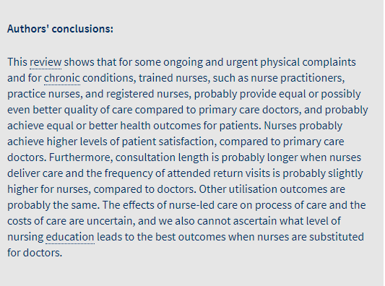





Slide 12
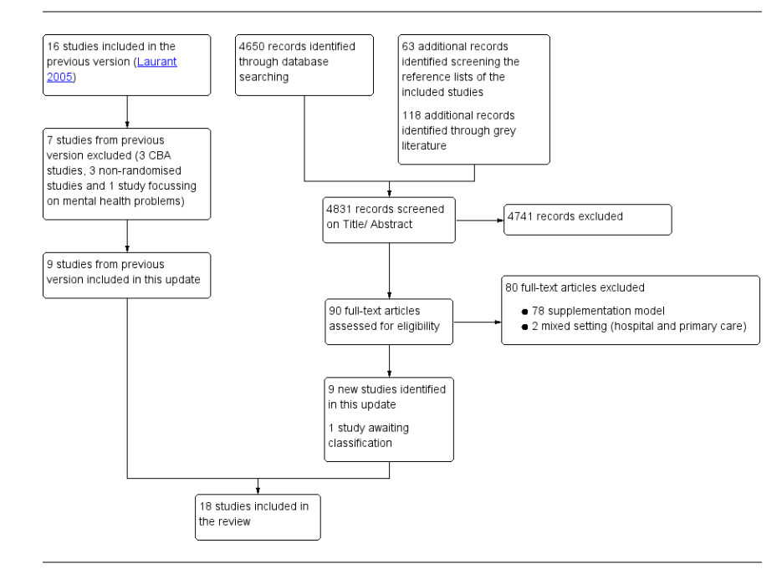




Total of 8885 records including those from the first review in 2005
Notes:
With the prior study screening and this one the total comes to 8885 studies (need to go back to first to verify)
Point – these are the 18 BEST studies they could find. We expect definitive answers clearly showing equal or better care. Let us see:

Slide 13
SETTINGS:
USA: 3 studies (Hemani, Lewis, Mundinger)
Canada: 3 studies
UK: 6 studies
Netherlands: 3 studies
Sweden: 1 study
Spain: 1 study
South Africa: 1 study
Notes:
Of 8885 studies there were only 3 of quality in the US. And these are OLD studies. Nothing of quality done between 2000 and 2018.
“ALSO - these are very short studies to exclude issues with missed diagnoses

Slide 14
Hemani (1999)
450 Baltimore VA patients, 100% supervised (attending physicians reviewed and signed off on charts, allowed to fix issues)
Topic: “resource utilization” – not diagnosis, treatment, or health outcomes
The only significantly significant finding: “In a primary care setting, nurse practitioners may utilize more health care resources than physicians.”
Notes:
Did not assess dx or tx – resource allocation ONLY
Nurses ordered 2.46 more CT/MR scans, 2.3 times more Ultrasound exams, and 1.5 times more Ophthalmology consultations than attending physicians. (All statistically significant).
Of note - the CT/MR and Ultrasound exams are among the most expensive diagnostic tests.
The authors speculate the orders were higher because of uncertainty: "Nurse practitioners may have encountered more uncertainty in their practice and ordered more of these tests in search of a diagnosis"

Slide 15
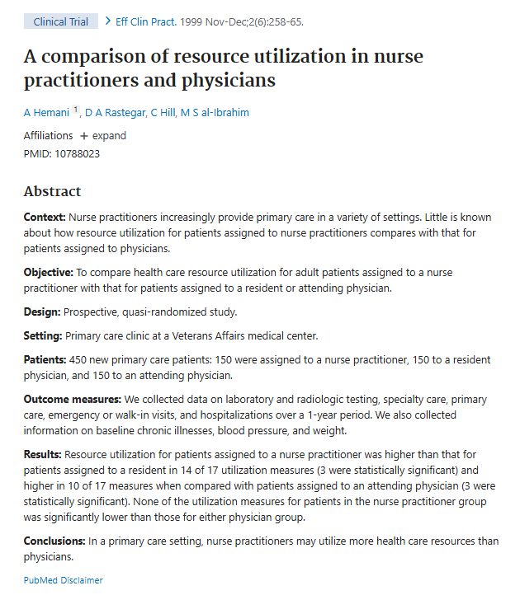

Notes:
A LOT more

Slide 16
Hemani (1999)
Nurses ordered 2.46x more CT/MRI scans, 2.3x more Ultrasound exams, and 1.5x more consultations than attending physicians
The authors speculate the orders were higher because of uncertainty: "Nurse practitioners may have encountered more uncertainty in their practice and ordered more of these tests in search of a diagnosis"
Notes:
Did not assess dx or tx – resource allocation ONLY
Nurses ordered 2.46 more CT/MR scans, 2.3 times more Ultrasound exams, and 1.5 times more Ophthalmology consultations than attending physicians. (All statistically significant).
Of note - the CT/MR and Ultrasound exams are among the most expensive diagnostic tests.
The authors speculate the orders were higher because of uncertainty: "Nurse practitioners may have encountered more uncertainty in their practice and ordered more of these tests in search of a diagnosis"

Slide 17
Lewis (1967)
66 patients, mostly women over 50 with lower socioeconomic status
ASKED: “Will patients accept seeing an NP?” (NPs were 100% supervised with daily chart reviews)
Notes:
Chime in

Slide 18
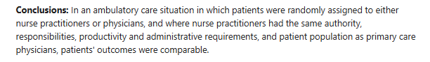
Mundinger (2000)
‘Primary care outcomes in patients treated by nurse practitioners or physicians: a randomized trial’
* With low risk, previously diagnosed patients, among NPs with extra training and physician mentorship

Slide 19
Mundinger (2000)
1300 Hispanic women in their mid-40s with ONE of the following: already diagnosed, stable diabetes, hypertension, or asthma
Followed over 6 months
No differences in simple outcomes of health self-assessment, A1c, blood pressure, peak flows
Notes:
We knew they couldn’t compete so we gave extra training – FIND THE CLIP

Slide 20
Mundinger (2000)
Physician oversight: available for consultation and NPs were assigned a physician mentor
NPs in this study were DNP / academic professors of nursing with an extra year of ‘residency’ to prepare for the study (not disclosed in original article)
Bias: Highest amount of bias in studies reviewed by Cochrane
Notes:
We knew they couldn’t compete so we gave extra training – FIND THE CLIP

Slide 21
Canadian studies
Spitzer (1974) – “Burlington Trial”
  100% supervised, low-risk patients
  NPs as safe and effective as a physician “most of the time” (55-67%)
  Chambers (1978)
  100% supervised
  No differences in patient outcomes when receiving first-contact care from a physician-supervised family practice nurse or care provided by a physician
Notes:
Very clear that they were 1:1 supervision

Slide 22
Venning (2000)
Cost of care: NPs in a walk-in clinic
1300 patients (2-week follow-up)
100% supervised (NPs required direct assistance 17% of the time)
RESULTS: No differences in cost → HOWEVER the article notes that study was inadequately powered to determine the cost-effectiveness of employing nurse practitioners in primary care

Slide 23
Venning (2000)
Authors quote:
“We have evaluated care given by nurse practitioners working as part of primary care teams alongside general practitioners. Our results do not therefore relate to nurse practitioners who are working independently."
The follow up period was only 2 weeks - inadequate to judge if the care given was effective.
The endpoints did not address adequacy of evaluation, or adequacy of treatment, they were primarily satisfaction and economic endpoints.

Slide 24
UK studies: Telephone triage (2/6)
Lattimer (1998) - experienced nurses could safely provide telephone triage advice after-hours independent of physicians using a software program guide
Campbell (2004) - Telephone triage by nurses reduced the workload of face-to-face visits for primary care physicians with no increase in adverse outcomes but did not save time or money

Slide 25
Shum (2000)
Evaluated “minor” medical complaints, excluded high-risk patients
100% supervised: Of 790 low-risk patients seen by nurses, 27% required evaluation by the physician
Researchers could not draw any conclusions about the safety of nurse-led care because the study group was not large enough to detect rare, adverse outcomes

Slide 26
Moher (2001)
100% supervised study – NPs followed physician-created protocols for blood pressure, cholesterol, and smoking status
- No new diagnosis or independent treatment

Slide 27
UK specialty care (2/6)
Larrsen (2014) – Rheumatology clinic, 100% supervised – nurses followed physician-created protocols to manage stable patients on rheumatoid medications
Chan (2012) – GI clinic, 100% supervised – nurses provided follow up visits for patients with mild dyspepsia (upset stomach) after endoscopy. Excluded high-risk patients

Slide 28
Netherlands studies
Voogdt‐Pruis (2010) Evaluated patients at risk for heart disease. 100% supervised, high-risk patients excluded. - NPs reduced risk factors when following physician-created protocols
Dierick‐van Daele (2009) – “first contact primary care.”
Conclusion: Inadequately powered to determine safety of NPs
Houweling (2011) – Non-insulin requiring DM2, 100% supervised. Patients initially evaluated by physicians, those thought to be too ill were not seen by nurses.
CONCLUSION: Inadequate patient sample to assess quality of care.

Slide 29
South Africa - Sonne (2010)
100% supervised study – NPs followed physician-created protocols to monitor HIV therapy on stable patients

Slide 30
Sweden - Ndosi (2013)
100% supervised study – NPs followed physician-created protocols to monitor diabetes control on stable patients
- NPs not allowed to prescribe medications

Slide 31
Spain - Iglesias (2003)
  Walk-in urgent care type clinic
  100% supervised, excluded high-risk patients
  Nurse practitioners managed 72% of minor burns, minor injuries, and diarrhea independently
  Only able to independently manage 17.5% of low back pain, 16% of colds, and 15% of urinary symptoms independently

Slide 32
SUMMARY
These are supposedly the best studies in the literature examining the question of primary care NP practice as of 2018
- All studies included 100% physician supervision, physician-created protocols
- Most studies excluded high-risk or complex patients
- Small sample size and non-diverse patient populations
- Average length of follow-up: 14 months

Slide 33
author | NPs see new patients?
Campbell | N/A &&
Chambers | yes
Chan | N/A &&
Diereck-van daele | yes
Hemani | yes
Houwelling | no
Iglesias | yes
Larrson | no
Lattimer | N/A &&
Lewis | no
Moher | no
Mundinger | no
Ndosi | no
Sanne | no
Shum | yes
Spitzer | yes
Venning | yes
Voogdt-Pruis | no
In eight studies, the NPs were not allowed to see new patients
Inappropriate to use this to support totally unsupervised care.

Slide 34
author | Were the nurses' diagnoses evaluated?
Campbell | no
Chambers | no
Chan | no
Diereck-van daele | no
Hemani | no
Houwelling | no
Iglesias | no
Larrson | no
Lattimer | no
Lewis | no
Moher | no
Mundinger | no
Ndosi | no
Sanne | no
Shum | no
Spitzer | no !!
Venning | no
Voogdt-Pruis | no
In 0 of 18 studies were the NPs abilities to diagnose examined
Inappropriate to use this to support totally unsupervised care.

Slide 35
author | Were the nurses' treatment plans evaluated?
Campbell | no
Chambers | no
Chan | no
Diereck-van daele | no
Hemani | no
Houwelling | no
Iglesias | no
Larrson | no
Lattimer | no
Lewis | no
Moher | no
Mundinger | no
Ndosi | no
Sanne | no
Shum | no
Spitzer | yes $
Venning | no
Voogdt-Pruis | no
In 1 of 18 studies, the NPs ability to form Treatment plans was examined
Inappropriate to use this to support totally unsupervised care.

Slide 36
author | were ill patients excluded from the nursing group?
Campbell | yes
Chambers | unclear
Chan | N/A
Diereck-van daele | yes
Hemani | yes
Houwelling | yes
Iglesias | yes
Larrson | yes
Lattimer | yes
Lewis | yes
Moher | unclear
Mundinger | yes *
Ndosi | yes
Sanne | yes
Shum | yes
Spitzer | unclear
Venning | yes
Voogdt-Pruis | yes
In fifteen studies, the NPs were not allowed to see patients who were actually ill
Inappropriate to use this to support totally unsupervised care.

Slide 37
author | number of NPs
Campbell | not reported
Chambers | 1
Chan | 1
Diereck-van daele | 12
Hemani | 9
Houwelling | 2
Iglesias | 155
Larrson | 5
Lattimer | 6
Lewis | 1
Moher | not reported
Mundinger | 7
Ndosi | 9
Sanne | 4
Shum | 5
Spitzer | 2
Venning | 20
Voogdt-Pruis | 6
Five studies were of 1 or 2 NPs
They were likely highly selected for their capabilities.
It is inappropriate to extrapolate this to 300,00 US NPs

Slide 38
author | was this a test of algorithm folowing?
Campbell | yes
Chambers | no
Chan | yes
Diereck-van daele | no
Hemani | no
Houwelling | yes
Iglesias | yes
Larrson | yes
Lattimer | yes
Lewis | no
Moher | yes
Mundinger | no
Ndosi | yes
Sanne | yes
Shum | no
Spitzer | no
Venning | no
Voogdt-Pruis | yes
In 10 of 18 studies, the NPs were only tested on their ability to follow an algorithm.
It is inappropriate to use this to support unsupervised practice.

Slide 39
author | was this physician led team practice
Campbell | N/A
Chambers | yes
Chan | yes
Diereck-van daele | yes
Hemani | yes
Houwelling | yes
Iglesias | yes
Larrson | yes
Lattimer | yes
Lewis | yes
Moher | yes
Mundinger | yes
Ndosi | yes
Sanne | yes
Shum | yes
Spitzer | yes
Venning | yes
Voogdt-Pruis | yes
In 17 of 18 studies, This was a physician led team practice model
It is inappropriate to use this to support unsupervised practice.

Slide 40
Laurants statement:
“Probably provide equal or possibly even better quality of care than primary care physicians”
When one actually reads the original papers:
You find there is nothing at all to support such a statement

Slide 41
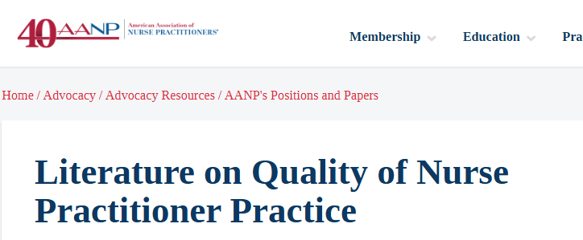
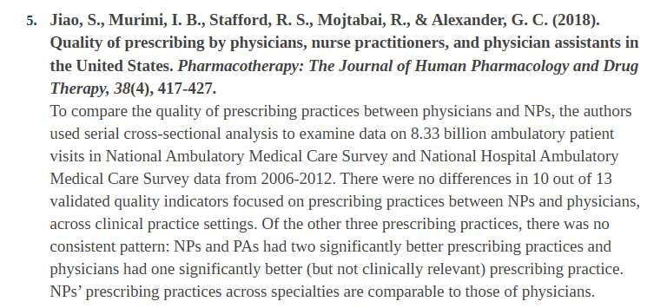
* When working in physician-led care teams

Slide 42
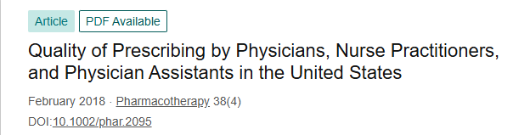
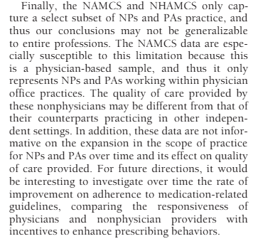






Slide 43
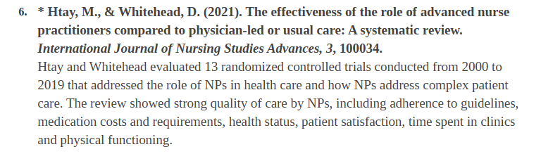

* In physician-led care teams with low-risk patients

Slide 44
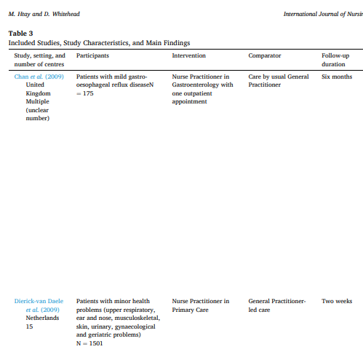
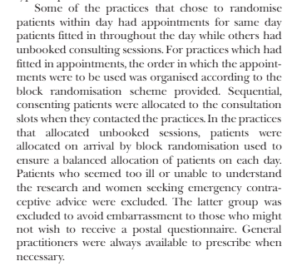
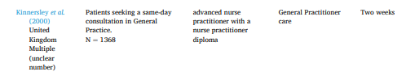





Slide 45
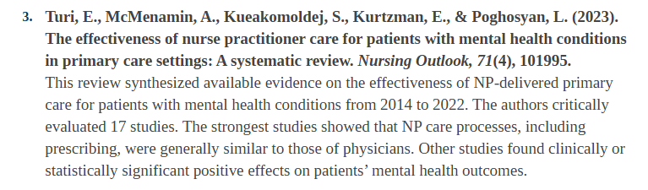
* According to the study authors: The quality of the evidence was poor

Slide 46
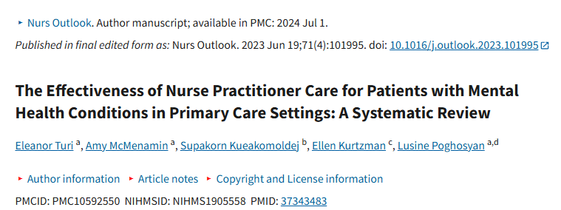
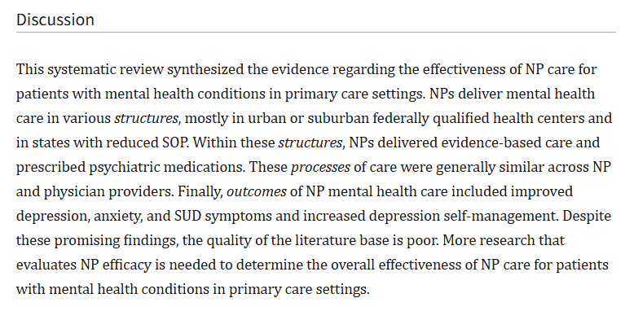


Slide 47
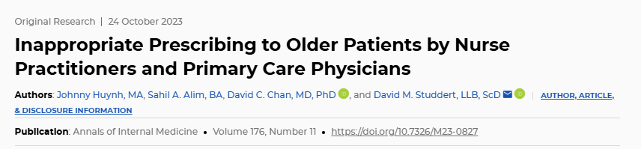
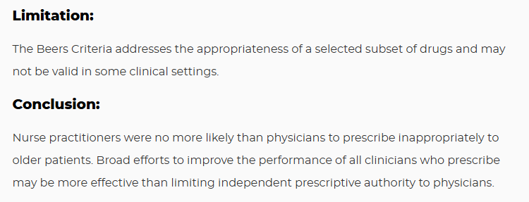

** On average… but there was a concerning finding for a subset of NPs

Slide 48
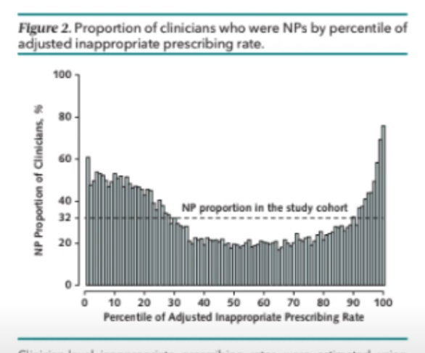
Authors: “NPs were Disproportionately overrepresented among the highest rates of inappropriate prescribing which raises concern about the lower tail of prescribing performance"
Who are these NPs?
We don’t know

Slide 49
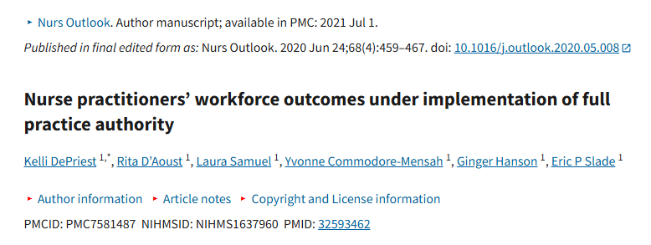
Most NPs are still working with physicians - 3.9% of full-time NPs in full practice authority states were self-employed (2021 data)

Slide 50
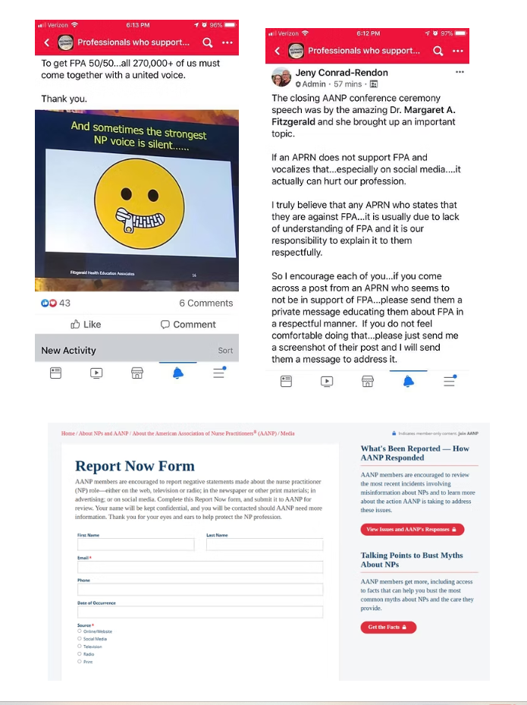
Many NPs want to work with physicians, but are being discouraged from speaking out…

Slide 51
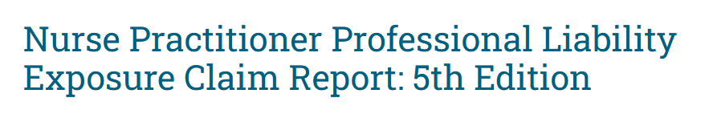
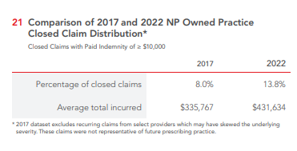
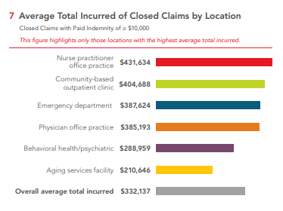
Malpractice claims for NP-owned practices are rising; highest payout among NP claims

Slide 52
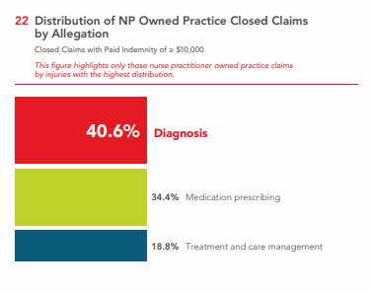
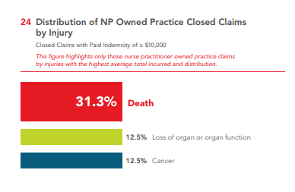
Most common claim among NP-owned clinic: Error in diagnosis
Most common injury among NP-owned clinic: Death

Slide 53
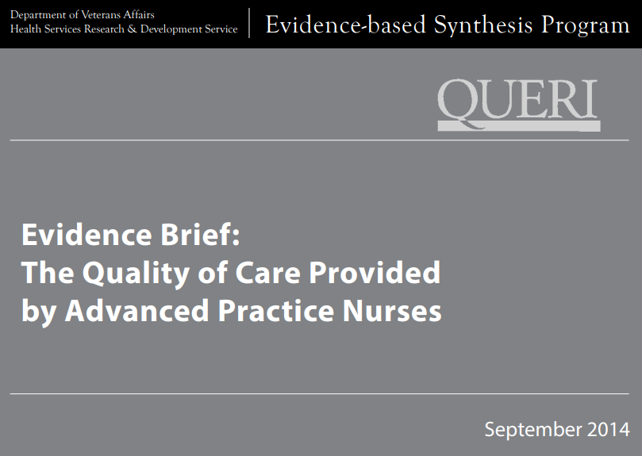
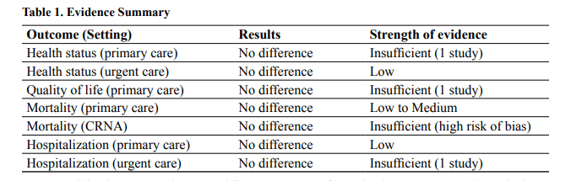


Slide 54
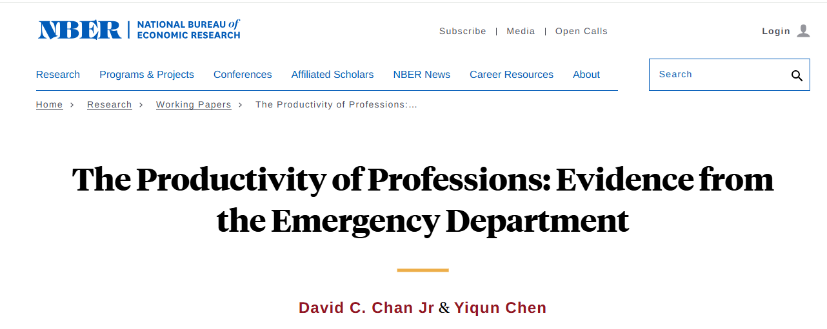
Chan VA ER study (2024)
NPs used more resources but achieved worse outcomes relative to physicians
Lower productivity surpassed pay differences between professions

Slide 55

“States with FPA have better health outcomes”
These paper show only CORRELATION
They do not prove causation.

Slide 56
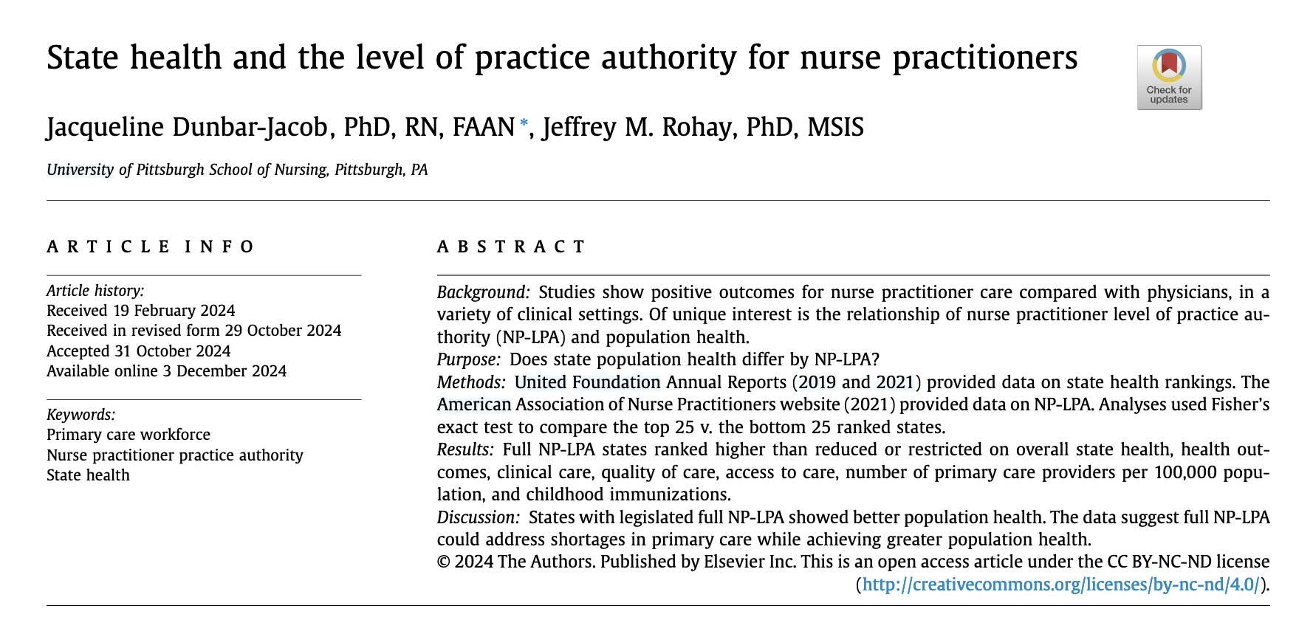
Most recent paper:
Notes:
How do you know when a speakder is trying to mislead you with this basic fallacy? First – any retrospective study has this as its fundamental flaw. Some adequately control for the other hidden variables that may also affect the result, but most do not.
Then the use of the phrases “is related to” or “is associated with” are tipoffs.
For example – I have shown you heare that more NPs in the US oare ASSOCIATED with an increase in overdose deaths, a rise in sea levels and increasing deaths from bedsheets. These statement are true – they ARE associatd. The “association” statement encourages you to immediately assume they caused these things. Do not do that

Slide 57
Factors that might affect general health of a state:
x
State policy environment
Demographics
Health infrastructure
Behaviors such as smoking, physical inactivity, nutrition, substance use.
Prevalence of chronic diseases like kidney disease, diabetes, obesity, coronary artery disease
Access measures such as coverage rates, affordability of care, availability of physicians.
Air and water quality, housing quality, urban/rural residence
Unsupervised practice of medicine in that state.
x
x
x
x
x
x

Slide 58
The authors- appropriately - do not claim causality.
And, therefore, that passage of an unsupervised practice of medicine law will NOT automatically improve a states health score.
However, most readers will subconsciously begin to assume that independent practice laws CAUSE better health.

Slide 59
This paper uses the words “associated” or ”association” 61 times.
And the words ”related” or ”relationship” 12 times.
It uses the word ”cause” zero times.
Key words to watch out for:
“is related to” or “is associated with”
Notes:
How do you know when a speakder is trying to mislead you with this basic fallacy? First – any retrospective study has this as its fundamental flaw. Some adequately control for the other hidden variables that may also affect the result, but most do not.
Then the use of the phrases “is related to” or “is associated with” are tipoffs.
For example – I have shown you heare that more NPs in the US oare ASSOCIATED with an increase in overdose deaths, a rise in sea levels and increasing deaths from bedsheets. These statement are true – they ARE associatd. The “association” statement encourages you to immediately assume they caused these things. Do not do that

Slide 60
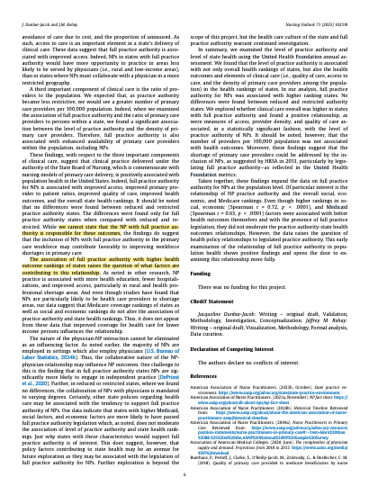
Therefore, the authors cannot say that independent practice laws produce (cause) better health outcomes
Inconspicuously included on the last page of the paper is this statement:
“We cannot state that the NP with full practice authority is responsible for these outcomes.”

Slide 61
Therefore, the authors cannot say that independent practice laws produce (cause) better health outcomes
And they note that other factors they have not studied may cause both better health care and passage of these laws:
“Certainly, other state policies regarding health care may be associated with the tendency to support full practice authority of NPs.’

Slide 62
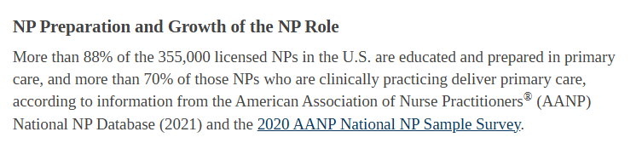



Questionable statistics
The Claim:
Heath Resources and Services Administration (HRSA) data:
Just 24% of NPs practiced primary care in 2022, down from 48% in 2018
The Reality:
https://bhw.hrsa.gov/data-research/projecting-health-workforce-supply-demand/technical-documentation/advanced-practice-nurse

Slide 63
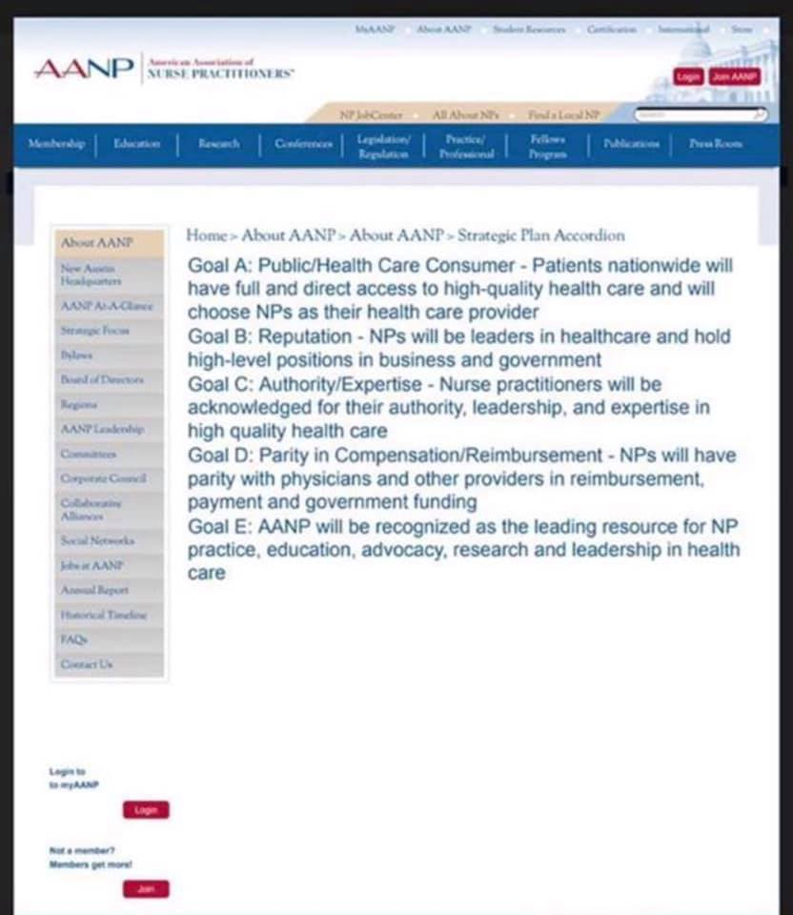






Slide 64
Compared with physicians, NPs and PAs…
Order more labs than physicians
Order more radiographic tests than physicians​​ (up to 440% more in one study)
Prescribe more medications in general than physicians
Prescribe more opioids than physicians - NPs/PAs practicing in states with independent prescription authority were > 20 times more likely to overprescribe opioids than NPs/PAs in prescription-restricted states​
Prescribe more antipsychotics to children than physicians
Prescribe more unnecessary antibiotics than physicians​
Place lower quality referrals than physicians
When caring for patients with diabetes, NPs were more likely to have consulted cardiologists, endocrinologists, and nephrologists ​
Perform significantly more biopsies than physicians to diagnose skin cancer and fail to diagnose melanoma-in-situ more often than physicians
Are more expensive than resident teams
Do not lower staffing costs

Slide 65
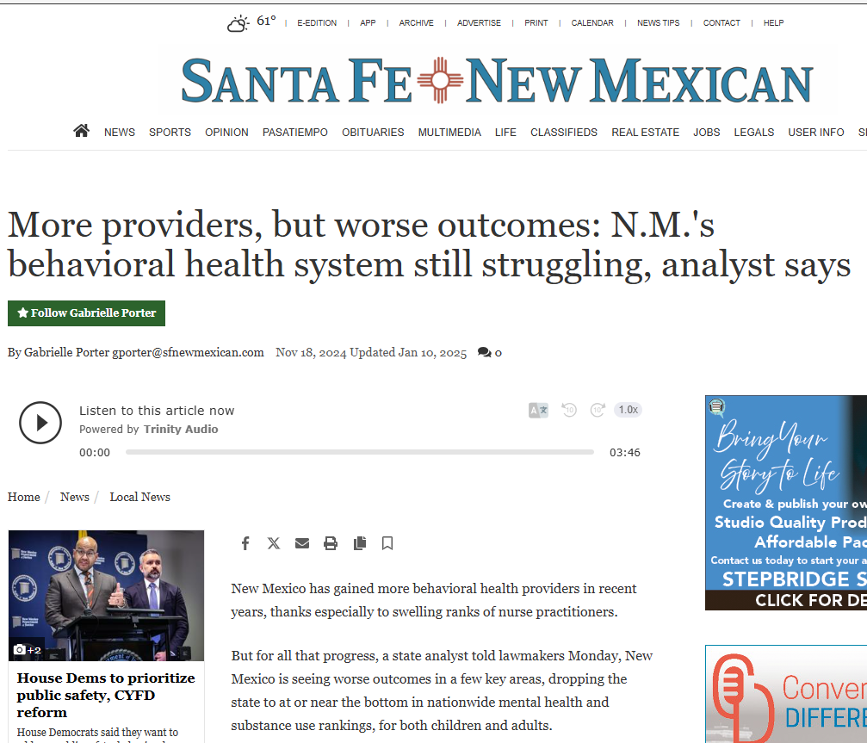

Slide 66
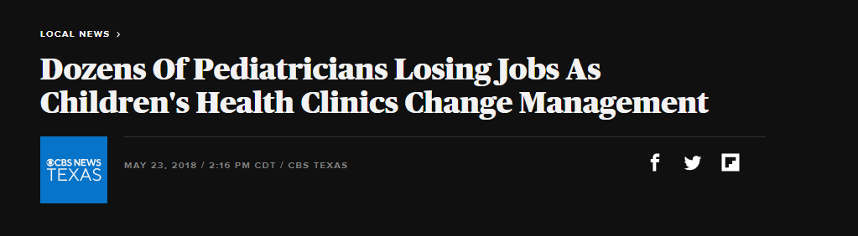
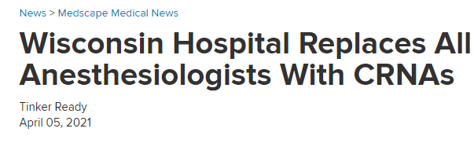
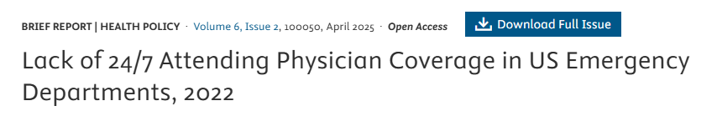
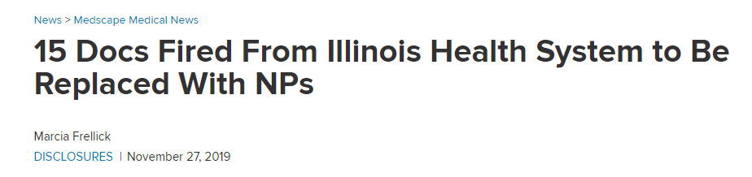
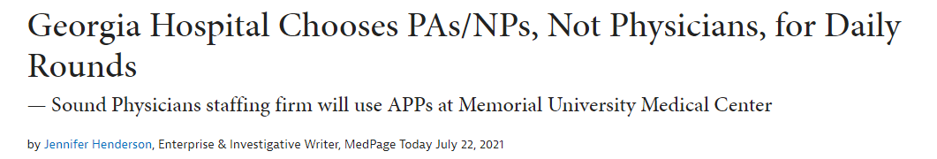
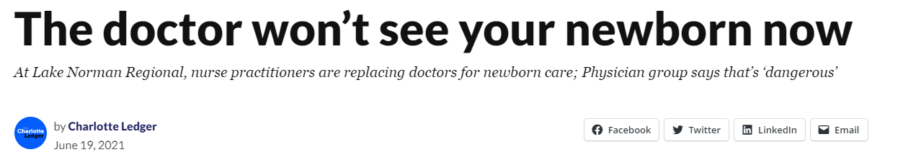


Slide 67
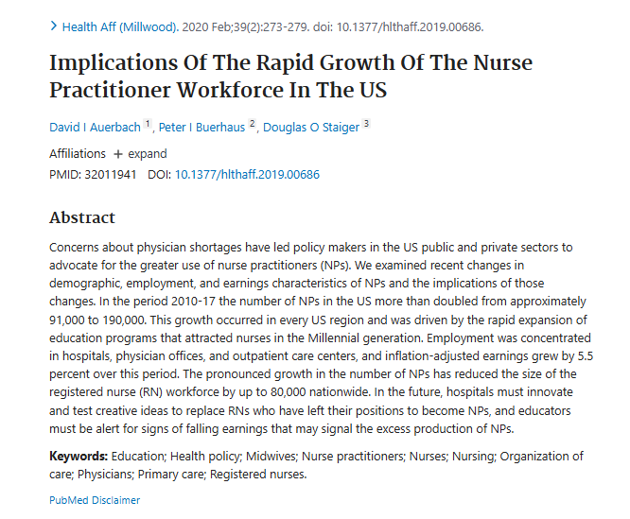
We need our bedside nurses!
There is already a critical nursing shortage
“The pronounced growth in the number of NPs has reduced the size of the registered nurse (RN) workforce by up to 80,000 nationwide.”

Slide 68
Thank you!
South Carolina patients deserve high-quality, cost-effective medical care
The data is clear: Physician-led care teams are best

